Slide 1
Unit-IV - Greedy Approach 05 Hrs.
General Strategy,
Knapsack Problem,
Single Source Shortest Path,
Minimum Spanning Tree (Prims and Kruskal Algorithm),
Job Sequencing with Deadline.

Slide 2


Knapsack Problem
According to the problem statement,
There are n items in the store
weight of ith item Wi > 0
Profit for ith item Pi > 0 and
capacity of the Knapsack is M or W
item can be completely selected or partially selected or nor selected,
the ith item contributes the weight Xi.Wi to the total weight in the Knapsack and profit Xi.Pi to the total profit.
the objective of this algorithm is to
an optimal solution can be obtained by

Slide 3
Algorithm: Greedy-Fractional-Knapsack (W[1..n], P[1..n], X[1..n], M)
// P(1:n) and W(1:n) contain the profits and weights respectively of the n objects ordered so that
//P(i) / W(i) >= P(i +1) / W(i + 1). M is the knapsack size and X(1 :n) is the solution vector
X ← 0
RM ← M // RM- remaining knapsack capacity
for i= 1 to n do
Compute Pi / Wi
Sort objects in descending order of Pi / Wi
for i= 1 to n do
{
if (RM > 0 && Wi <= RM)
{
RM= RM - Wi
P= P + Pi
X[i] = 1
}
else
break;
}
If (RM > 0)
{ X [i] = RM / Wi
P= P + (Pi * (RM / Wi) )
}
Return X

Slide 4
Knapsack Problem
GREEDY _KNAPSACK(P, W. M, X)
1. real P(l:n), W(l:n), X(l:n), M. cu;
2. integer i, n ;
3. X ← 0 //initialize solution to zero
4. cu ← M // cu = remaining knapsack capacity
5. for i - 1 to n do
6. if W(i) > cu then exit endif
7. X(i) ← 1
8. cu ← cu - W(i)
9. repeat
10. if i <= n then X(i) ← cu/W(i) endif
11. end GREEDY _KNAPSACK

Slide 5
M= 75
P= ( 280, 100, 120 ,120 )
W= ( 40, 10, 20, 24 )
Object | Weight of Object | Weight in knapsack | Remaining Weight | Profit due to object | Total Profit | Xi

Slide 6
M= 21
P= (10, 5, 15, 7, 6, 18, 3)
W= (2, 3, 5, 7, 1, 4, 1)

Slide 7
M= 100
P = ( 20, 30, 66, 40, 60 )
W = ( 10, 20, 30, 40, 50 )

Slide 8
Object | Weight of Object | Remaining Weight | Profit due to Object | Total profit
 | 10 | 75-10=65 | 100 | 100
 | 40 | 65-40=25 | 280 | 100+280=380
 | 20 | 25-20=5 | 120 | 120+380=500
 | 24 | 5-5=0 | 25 | 500+25=525

Slide 9
JOB SEQUENCING WITH DEADLINES
We are given a set of n jobs.
Associated with job i is an integer with deadline d >0 and a profit p > 0.
For any job i the profit Pi is earned iff the job is completed by its deadline.
In order to complete a job one has to process the job on a machine for one unit of time.
Only one machine is available for processing jobs.
A feasible solution for this problem is a subset, J, of jobs such that each job in this subset can be completed by its deadline.
The value of a feasible solution J is the sum of the profits of the jobs in J. An optimal solution is a feasible solution with maximum value of Profit.
Highest deadline = number of time units

Slide 13
Profit (10, 15, 5, 20 ) deadline (2,1,1,2)
1 2 3
X1 | X2 | X3 | X4
10 | 15 | 5 | 20
2 | 1 | 1 | 2

Slide 14
Profit (10, 15, 5, 20 ) deadline (2,1,1,2)
1 2 3
X1 YES
X1 | X2 | X3 | X4
10 | 15 | 5 | 20
2 | 1 | 1 | 2

Slide 15
Profit (10, 15, 5, 20 ) deadline (2,1,1,2)
1 2 3
X1 YES
X1 | X2 | X3 | X4
10 | 15 | 5 | 20
2 | 1 | 1 | 2

Slide 16
Profit (10, 15, 5, 20 ) deadline (2,1,1,2)
1 2 3
X1 NO
X1 | X2 | X3 | X4
10 | 15 | 5 | 20
2 | 1 | 1 | 2

Slide 17
Profit (10, 15, 5, 20 ) deadline (2,1,1,2)
1 2 3
X1
X1 | X2 | X3 | X4
10 | 15 | 5 | 20
2 | 1 | 1 | 2

Slide 18
Profit (10, 15, 5, 20 ) deadline (2,1,1,2)
1 2 3
X1 X2 NO
X1 | X2 | X3 | X4
10 | 15 | 5 | 20
2 | 1 | 1 | 2

Slide 19
Profit (10, 15, 5, 20 ) deadline (2,1,1,2)
1 2 3
X1 X3 NO
X1 | X2 | X3 | X4
10 | 15 | 5 | 20
2 | 1 | 1 | 2

Slide 20
Profit (10, 15, 5, 20 ) deadline (2,1,1,2)
1 2 3
X1 X4 YES
X1 | X2 | X3 | X4
10 | 15 | 5 | 20
2 | 1 | 1 | 2

Slide 21
Profit (10, 15, 5, 20 ) deadline (2,1,1,2)
1 2 3
X1 X4 YES 30
X2 X1 YES 25
X2 X4 YES 35
X3 X1 YES 15
X3 X4 YES 25
X1 | X2 | X3 | X4
10 | 15 | 5 | 20
2 | 1 | 1 | 2

Slide 23
0 1 2 3
1 | 2 | 3 | 4 | 5
20 | 15 | 10 | 5 | 1
2 | 2 | 1 | 3 | 3

Slide 24
Dijkstra Algorithm
{
if( d(u) + c(u, v) < d(v))
d(v) = d(u) +c(u, v)
}
formula for calculating the distance between the vertices

Slide 25
Dijkstra’s Algorithm

Slide 26
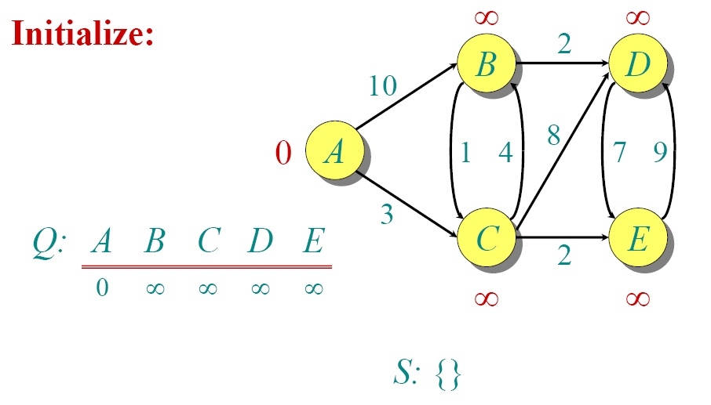
Dijkstra Animated Example

Slide 27
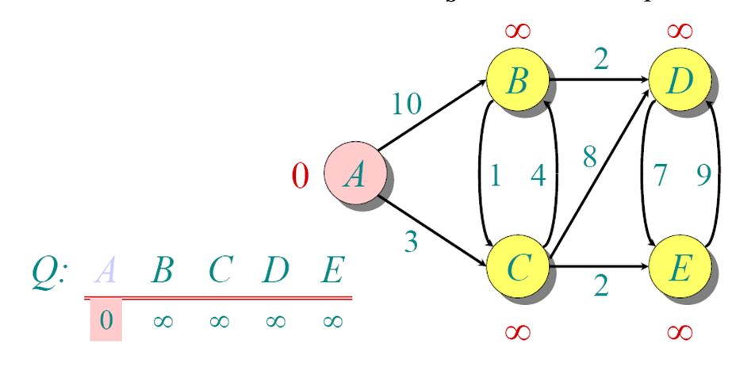
Dijkstra Animated Example

Slide 28
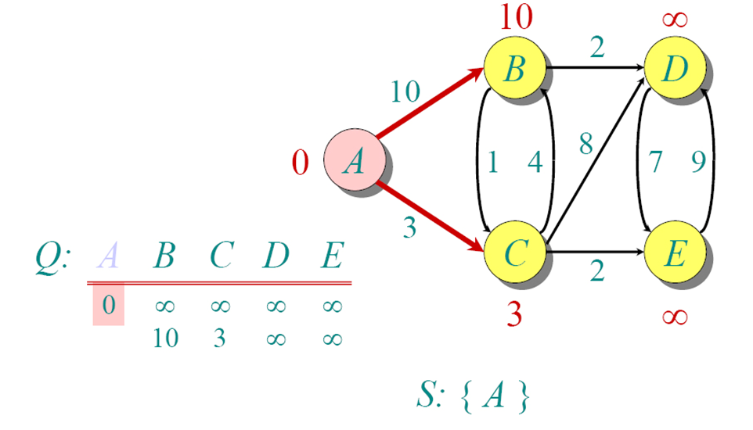
Dijkstra Animated Example

Slide 29
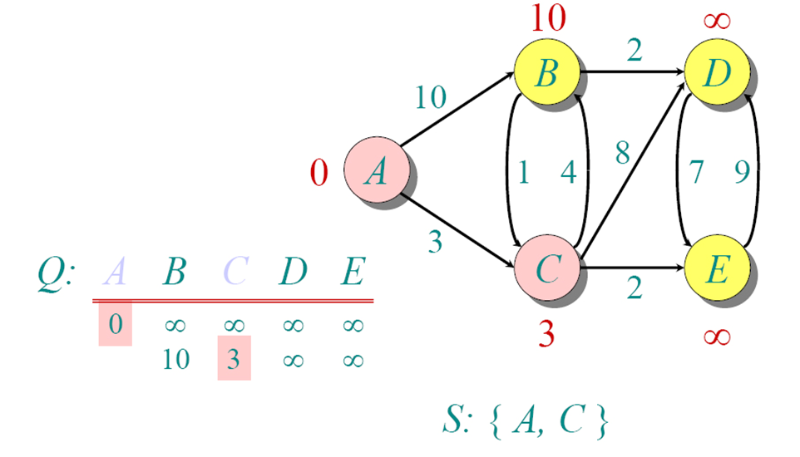
Dijkstra Animated Example

Slide 30
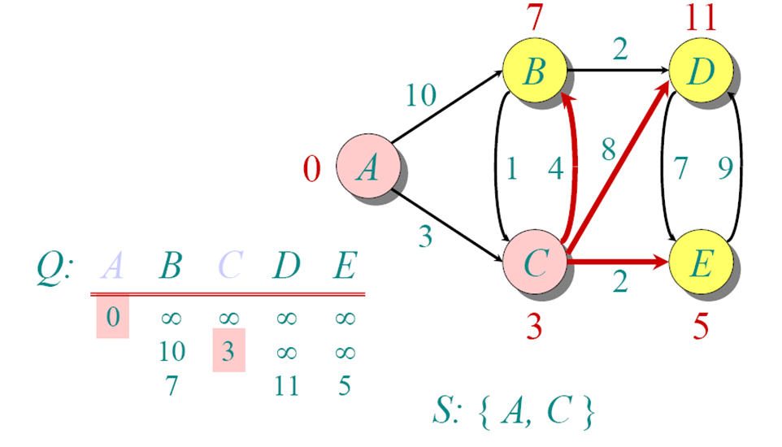
Dijkstra Animated Example

Slide 31
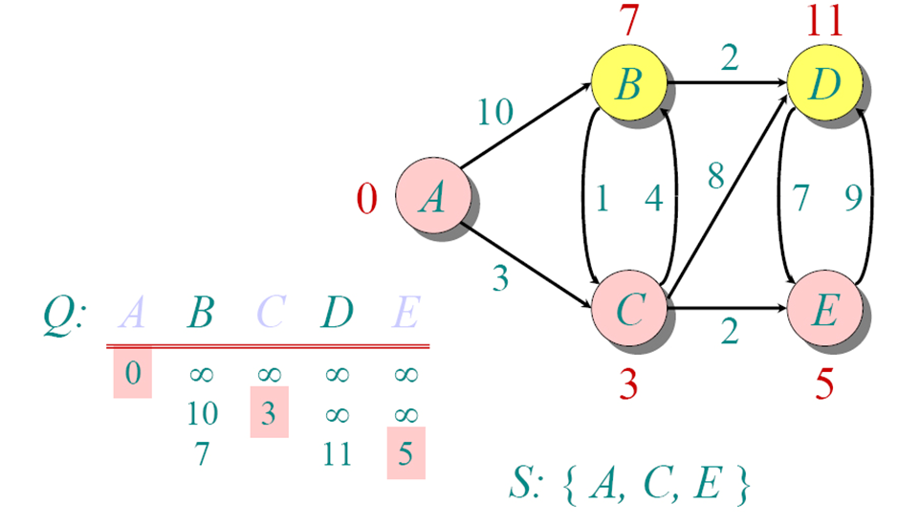
Dijkstra Animated Example

Slide 32
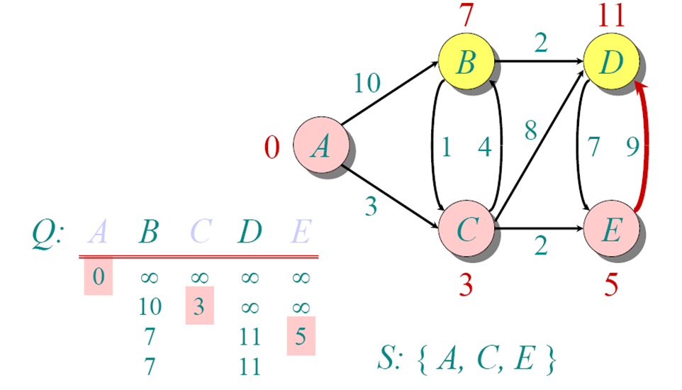
Dijkstra Animated Example

Slide 33
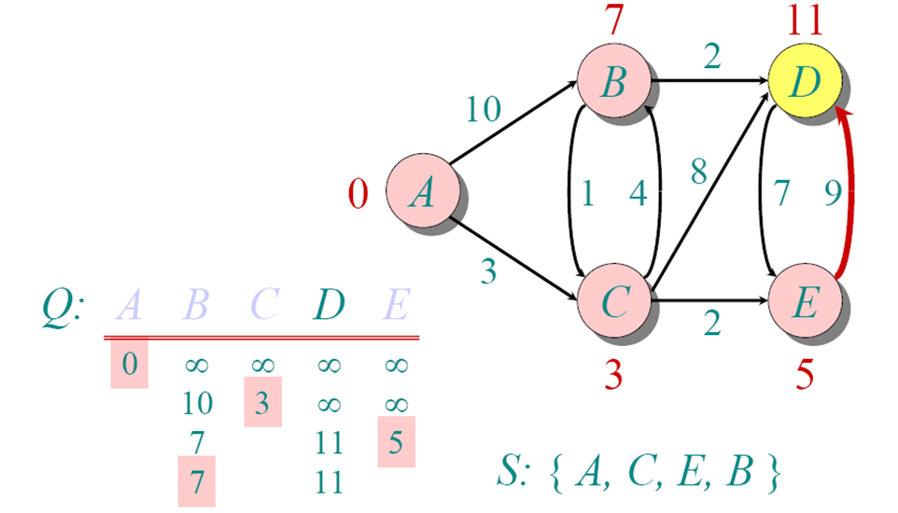
Dijkstra Animated Example

Slide 34
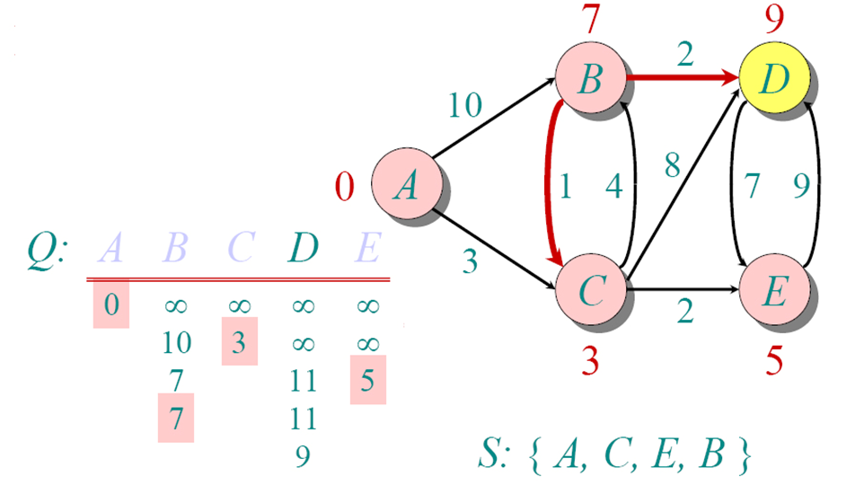
Dijkstra Animated Example

Slide 35
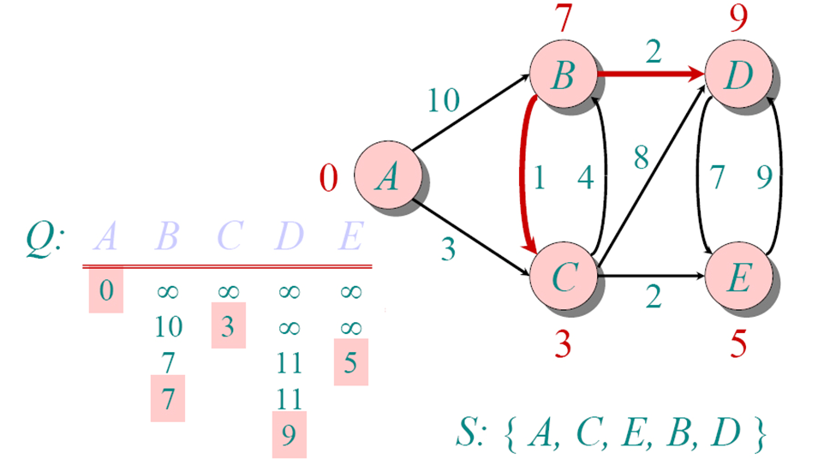
Dijkstra Animated Example

Slide 36
V | A | B | C | D | E
A | 0 | ∞ | ∞ | ∞ | ∞
C | 0 | 10 | 3 | ∞ | ∞
E | 0 | 7 | 3 | 11 | 5
B | 0 | 7 | 3 | 11 | 5
D | 0 | 7 | 3 | 9 | 5
SET S
{ A }
{ A , C }
{ A , C , E }
{ A , C , E , B }
{ A , C , E , B , D}

Slide 40
Minimum Spanning Tree (MST)
For a connected and undirected graph, a spanning tree of that graph is a subgraph that is a tree and connects all the vertices together. A single graph can have multiple spanning trees.
A Spanning Tree is a tree which have V vertices and V-1 edges. All nodes in a spanning tree are reachable from each other.
A Minimum Spanning Tree(MST) or minimum weight spanning tree for a weighted, connected, undirected graph is a spanning tree having a weight less than or equal to the weight of every other possible spanning tree.
The weight of a spanning tree is the sum of weights given to each edge of the spanning tree.
In short out of all spanning trees of a given graph, the spanning tree having minimum weight is MST.

Slide 41
Minimum Spanning Tree -
Kruskal’s algorithm –
In Kruskal’s algorithm, the set A is a forest whose vertices are all those of the given graph. The safe edge added to A is always a least-weight edge in the graph that connects two distinct components.
2. Prim’s algorithm –
In Prim’s algorithm, the set A forms a single tree. The safe edge added to A is always a least-weight edge connecting the tree to a vertex not in the tree.

Slide 42
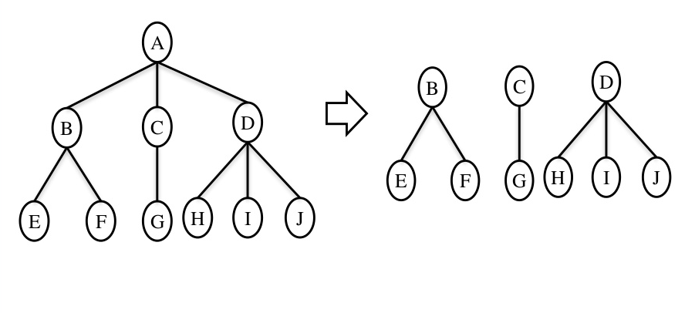
Tree Forest

Slide 43
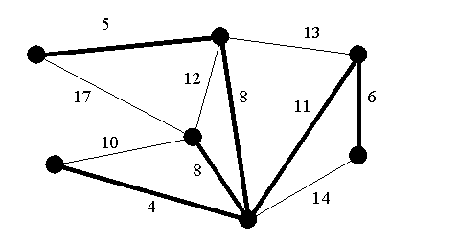
Minimum spanning tree in graph

Slide 44
Minimum Spanning Tree
Kruskal’s algorithm –
In Kruskal’s algorithm, the set A is a forest whose vertices are all those of the given graph. The safe edge added to A is always a least-weight edge in the graph that connects two distinct components.
Kruskal’s algorithm finds a safe edge to add to the growing forest by finding, of all the edges that connect any two trees in the forest, an edge (u,v) of least weight. Let C1 and C2 denote the two trees that are connected by (u,v). Kruskal’s algorithm qualifies as a greedy algorithm because at each step it adds to the forest an edge of least possible weight.

Slide 45
Kruskal’s algorithm
Sort all the edges in non-decreasing order of their weight.
Pick the smallest edge. Check if it forms a cycle with the spanning tree formed so far. If the cycle is not formed, include this edge. Else, discard it.
Repeat step#2 until there are (V-1) edges in the spanning tree.

Slide 52
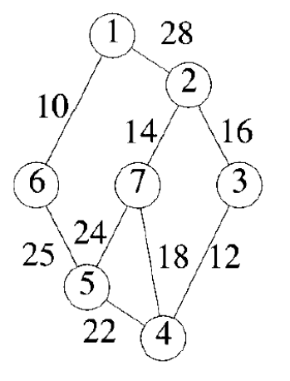

Slide 56
Prims Algorithm –
Like Kruskal’s algorithm, Prim’s algorithm is a special case of the generic minimum- spanning-tree method.
Prim’s algorithm operates much like Dijkstra’s algorithm for finding shortest paths in a graph.
It has the property that the edges in the set A always form a single tree.
The tree starts from an arbitrary root vertex r and grows until the tree spans all the vertices in V . Each step adds to the tree A a light edge that connects A to an isolated vertex—one on which no edge of A is incident. This rule adds only edges that are safe for A; therefore, when the algorithm terminates, the edges in A form a minimum spanning tree.
This strategy qualifies as greedy since at each step it adds to the tree an edge that contributes the minimum amount possible to the tree’s weight.

Slide 57
Prims Algorithm
Step 1: Determine an arbitrary vertex as the starting vertex of the MST. Step 2: Follow steps 3 to 5 till there are vertices that are not included in the MST (known as fringe vertex). Step 3: Find edges connecting any tree vertex with the fringe vertices. Step 4: Find the minimum among these edges. Step 5: Add the chosen edge to the MST if it does not form any cycle. Step 6: Return the MST and exit

Slide 63
